Slide 1

INTEGRET DEVELOPPEMENT ENVIRONMENT
"OpenCobolIDE"

Slide 2
Introduction:
1: Presentation
2: Introduction for OpenCobolIDE
3: Who uses opencobolIde
4: Interfaces of cobol

Slide 3
1: Presentation
An IDE is a plateform when developper can write, test our application.
An IDE is a factor of developpement human.
An IDE support of numeric work
I can say no IDE, a developper cannot work, and a computer is useless.

Slide 4
2: Introduction for OpenCobolIDE
OpenCobolIDE is an environment where developper code in the language Cobol.
Cobol in large form is common business oriented language.
Cobol is create in 1959 by the ladie Grace Hopper for an US army.
Cobol is a language used in business world.

Slide 5
3: Who uses opencobolIde
Cobol is primarily used in business, finance and admnistration system for compagnies and government.

Slide 6
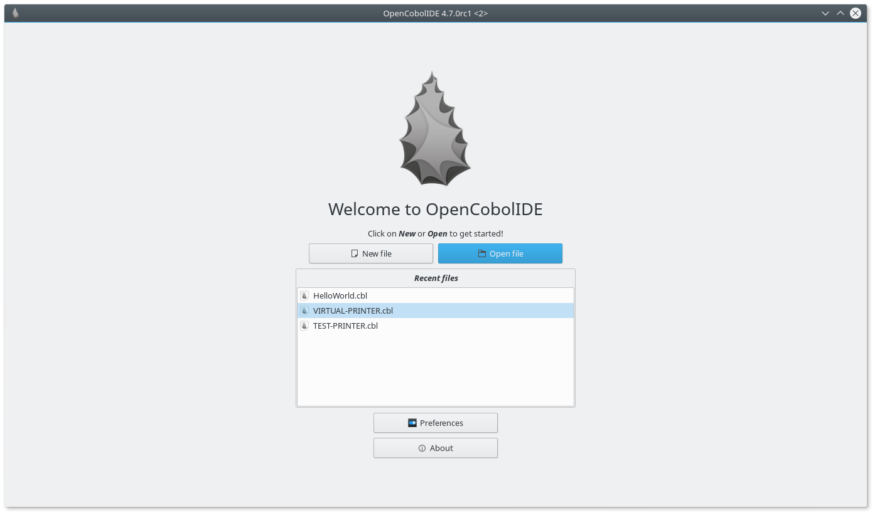
4:
Interface of OpenCobolIDE
Cliquez pour ajouter du texte

Slide 7

IDENTIFICATION DIVISION.
PROGRAM-ID. HELLO.
DATA DIVISION.
WORKING-STORAGE SECTION.
EXEC SQL INCLUDE SQLCA END-EXEC.
EXEC SQL INCLUDE STUDENT END-EXEC.
EXEC SQL BEGIN DECLARE SECTION END-EXEC.
01 WS-STUDENT-REC.
05 WS-STUDENT-ID PIC 9(4).
05 WS-STUDENT-NAME PIC X(25).
05 WS-STUDENT-ADDRESS X(50).
EXEC SQL END DECLARE SECTION
END-EXEC.
EXEC SQL
DECLARE STUDCUR CURSOR FOR
SELECT STUDENT-ID, STUDENT-NAME, STUDENT-ADDRESS FROM STUDENT
WHERE STUDENT-ID >:WS-STUDENT-ID
END-EXEC.

Slide 8
PROCEDURE DIVISION.
MOVE 1001 TO WS-STUDENT-ID.
PERFORM UNTIL SQLCODE = 100
EXEC SQL
FETCH STUDCUR
INTO :WS-STUDENT-ID, :WS-STUDENT-NAME, WS-STUDENT-ADDRESS
END-EXEC
DISPLAY WS-STUDENT-REC
END-PERFORM
STOP RUN.

Slide 9


